Slide 1
Analyzing Battery Data From Hybrid-Electric Buses
Elena Toups, Chris Gould, Babita Giri, Phil Romero
“The Battmobile”

Slide 2


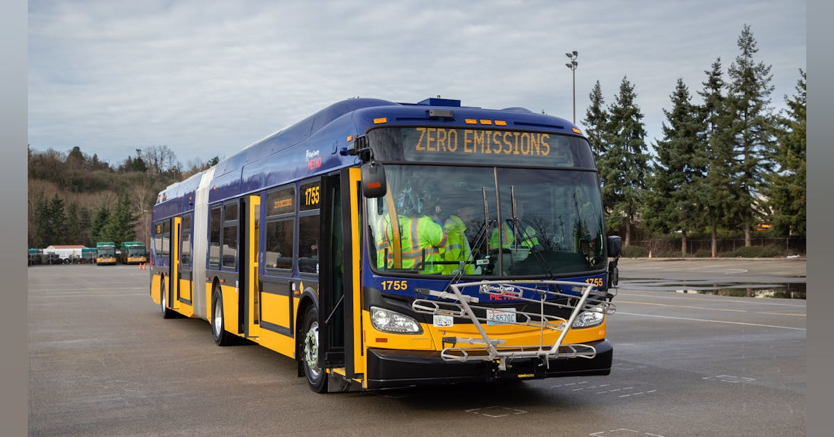
Vehicle Electrification
Transportation sector large contributor to annual CO₂ emissions
Hybrid-Electric & Battery-Electric vehicles
Difficult to manage a new energy system
Vast quantities of new data produced
https://www.masstransitmag.com/bus/vehicles/hybrid-hydrogen-electric-vehicles/press-release/21123698/king-county-metro-transit-king-county-metro-to-purchase-up-to-120-battery-electric-buses-from-new-flyer-of-america-inc
Notes:
Transportation sector is the largest contributor of carbon emissions annually
Transit agencies have begun to address this by transitioning away from internal combustion engines and toward electric vehicles
For example, HEV that use battery systems to increase fuel efficiency and battery-electric vehicles that fully rely on battery systems for propulsion
Whats different about these systems is that the batteries don’t last the full lifetime of the car but need to be replaced
This transition has been pretty sudden and we now have an influx of battery data on our hands and it is difficult to know how to use it to best determine battery health and performance

Slide 3

Use Case: King County Metro
Largest hybrid-electric bus fleet in the country
Predictive Maintenance: only use one indicator to determine battery health & performance
BUT on-board battery management system also collects:
Voltage
Current
Power
Temperature
Cell sensors (on/off)
Other useful metrics...

Slide 4




Software Design
X number of files from X buses, X visits, with X modules, X_submodules, cells...
Introducing:
Alfred!
Extract, Transform, Load
Visualize
Analyze
Notes:
Every time a King county metro hybrid bus comes in for a maintenance visit a file is downloaded which contains its battery history. Our data set contains data following around 200 hybrid buses over the course of 2 years. Some of these buses have multiple maintenance visits which means multiple data files. Each data file contains information on the entire battery pack which is broken down into 16 modules and even further into the 12 submodules. So extracting any valuable information from this data it seems like a daunting task.
Introducing our software package alfred!
afred is able to extract your data, sort through it, and organize it into sub sets so the data can be visulaized and processed for higher analyzed
2017 to 2019

Slide 5
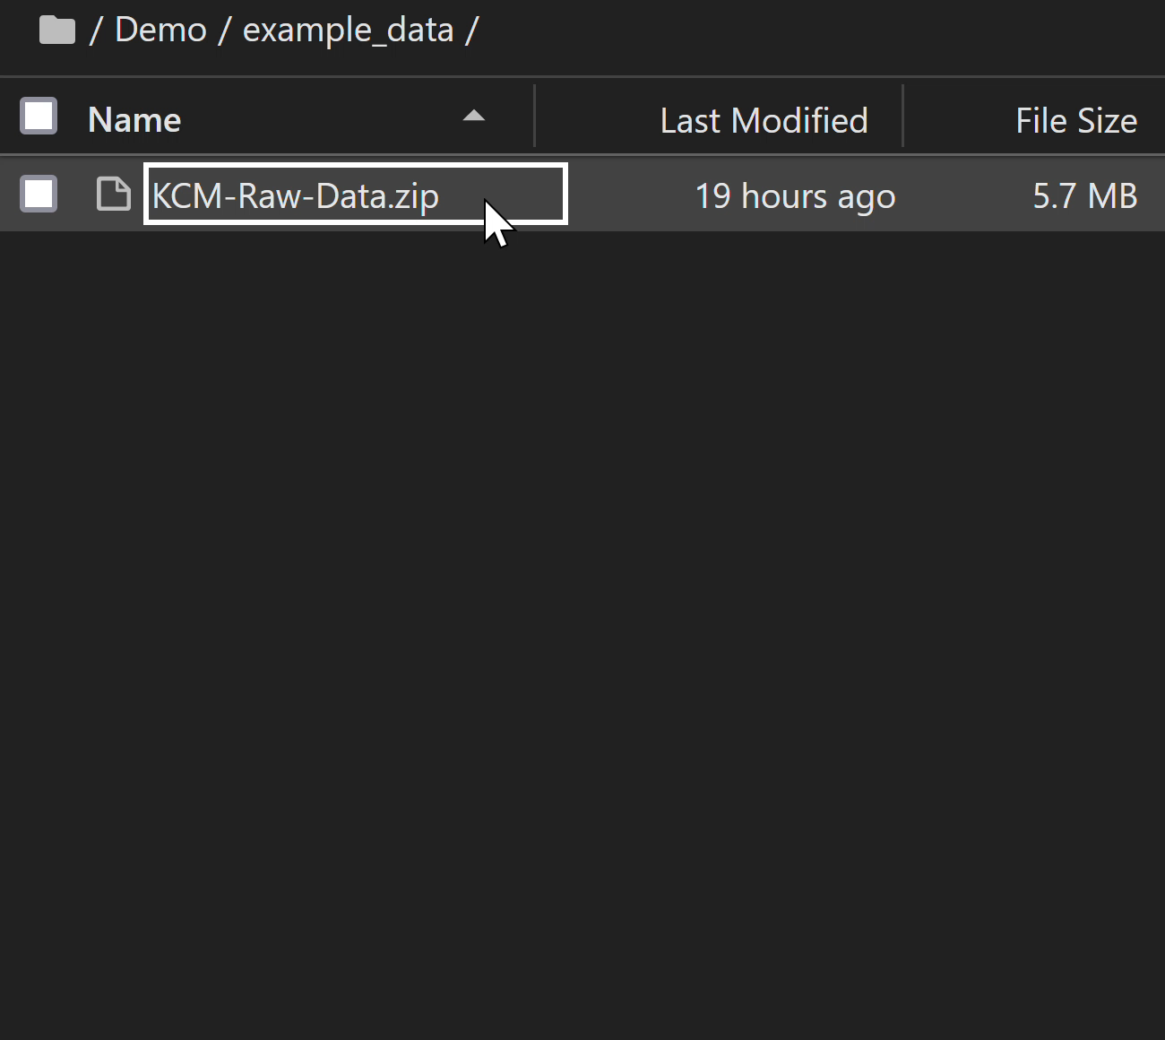
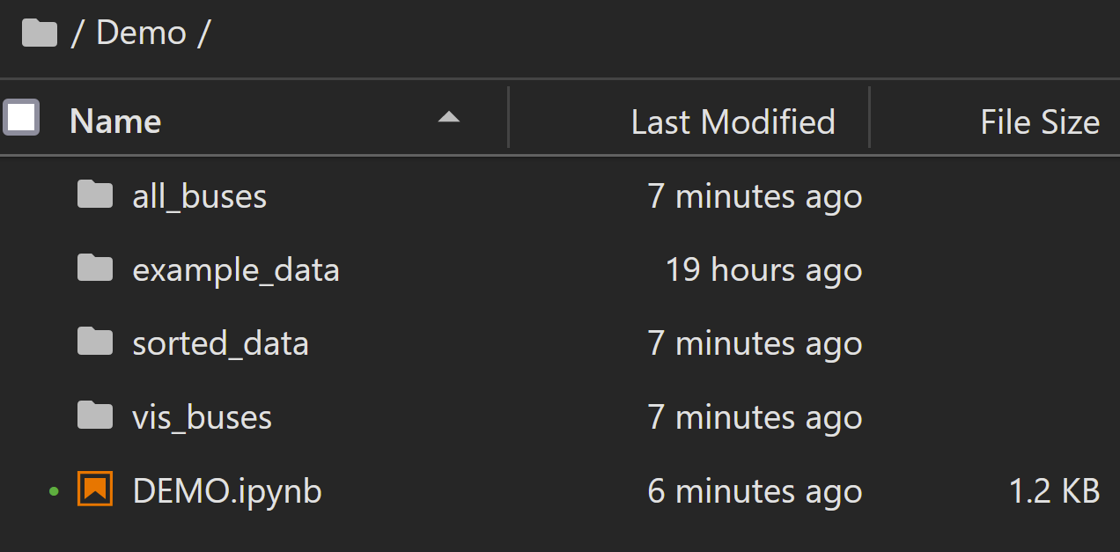



Extract, Transform, Load
Etl.py
Extracts data from zip file
Sorts files into bus folders
Groups folders into directories
Sorted_data
Vis_buses
All_buses
Notes:
Etl it our first module in our package. This will find your zip file, unpack it, parse though them and organize them into their respective buses. It will then organize the the files by date with in each bus folder and sort them into 3 different directories.
Vis buses conatin buses with 3 or more maintenance visits. These buses have the most extensive history in our data set so they can be useful for identifying replaced modules which can allow us to label modules as good or bad
Sorted = remainder
All = concatenated list of all the buses

Slide 6

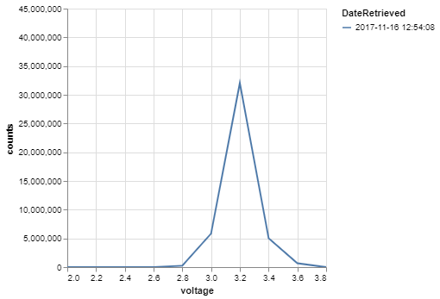
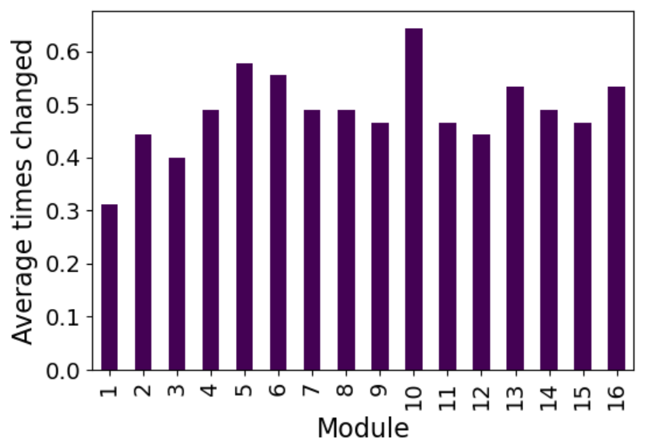
Visualize
Vis.py
Builds data frames of quantifiable information from BMS
Voltage
Time
Temperature
Module Changes
Presents this data through visual plots
Notes:
Now from the sorted data set, we are now ready to choose which information we would like to display. The vis.py module within Alfred is specifically built to take the information from each bus and present it through various visual plots such as bar graphs, line graphs, or histograms. This includes visualizing anything from how many times a module is in a specific voltage range, to how many times on average a specific module is swapped out. To view these plots, vis.py has a list of purpose-built functions that calls on the directory created from ETL and creates data frames based on which variable you want to call. So we have a visualization of the data, now what?

Slide 7
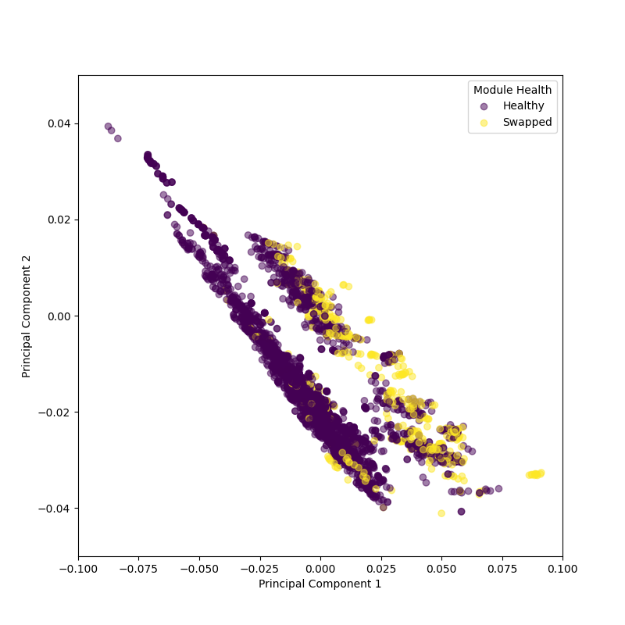
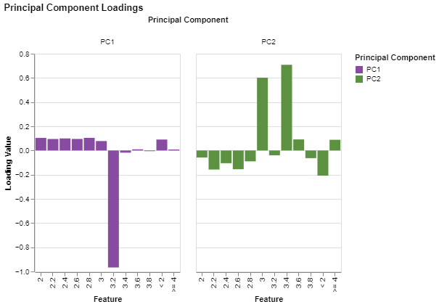

Analyze
Analysis.py
Takes voltage data frames created in vis.py
Prepares data frames for analysis
Finds problematic buses and removes those files
Standardizes size of data
Output is a Principal Component Analysis (PCA)
Notes:
That is where analysis.py comes in. It’s purpose is to run a Principal Component Analysis or PCA on the data in order to get better understanding on why specific battery modules on the bus are failing. Now for those of you who don’t know, a PCA is a technique used by data scientists that captures the largest variation in the data by reducing the dimensionality of large data sets like this one and transforms it into a smaller data set that still contains the important information from the data set. The result is an easier way to analyze the data visually or with machine-learning. The Analysis.py module takes the data frames created in Vis.py, it then transforms that data so that it is able to be run using a PCA. The transformation process includes removing bus files that are in the wrong format or has no information, as well as standardizing the size of the data to be analyzed.

Slide 8

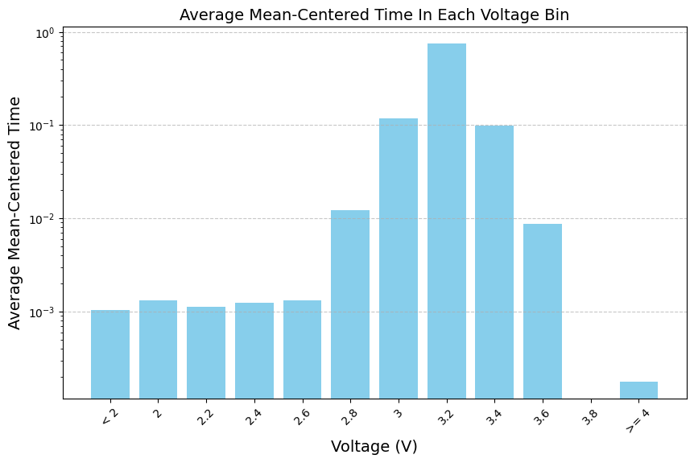
Outcomes
Feature Extraction
PC's capture variance away from average voltage
Can separate clusters of battery modules
Manufacturing or performance differences
Notes:
So why is this important? Well this analysis extracts important features from the dataset about the battery’s health and performance. It does this by generating principal components, where each component captures a unique variance away from the mean. Our package currently supports analyzing voltage data for battery modules. So you can see in the histogram, what the average voltage profile looks like. The batteries are LFP so they like to live at 3.2 volts which is their nominal voltage, the surrounding disruption is their operational range. And when you plot the principal components against each other, you can watch them separate out the battery modules into unique clusters. Yellow=swapped, purple=healthy. The clusters in some of these images you see could be from performance or manufacturing differences.

Slide 9
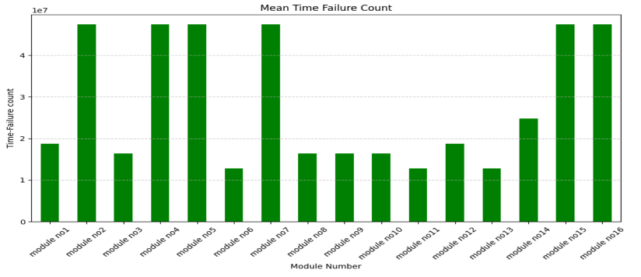
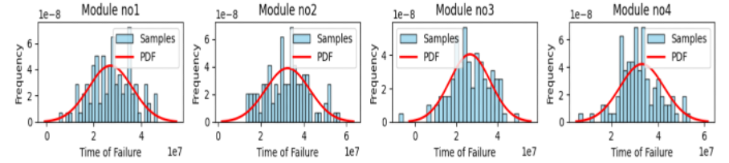
Additional Outcomes
Meantime Time of Failure
Bar chart
Histogram with PDF overlay

Slide 10
Future Work
Current Software
Build more statistical learning modules into our package
Use these tools to collect and condense insights
Build a user interface
Eventually...
A predictive machine learning model
Notes:
Imminent work we’d like to accomplish with our current software is build more modules into our package for statistical learning so gain more insights about the dataset we have
We’d then like to condense these insights so that we can determine what the unique profile of a failing module looks like
We’d also like to build a user interface, likely in the form of a website, ran with our aflred packages that makes it easy for a user to drag and drop files and have then sorted and interpreted
Lastly, all of this work supports building a predictive machine learning model that can interpret whether specific modules are on their way to failure.

Slide 11


Thank you
Questions or want to get involved?
https://github.com/TheBattCave/TheBattmobile

